Slide 1
Evolutionary Computing
Chapter 7
Parameters and Parameter Tuning

Slide 2
Overview
History
Taxonomy
Parameter Tuning vs Parameter Control
EA calibration
Parameter Tuning
Testing
Effort
Recommendation

Slide 3
Brief historical account
1970/80ies “GA is a robust method”
1970ies + ESs self-adapt mutation stepsize σ
1986 meta-GA for optimizing GA parameters
1990ies EP adopts self-adaptation of σ as ‘standard’
1990ies some papers on changing parameters on-the-fly
1999 Eiben-Michalewicz-Hinterding paper proposes
clear taxonomy & terminology

Slide 4
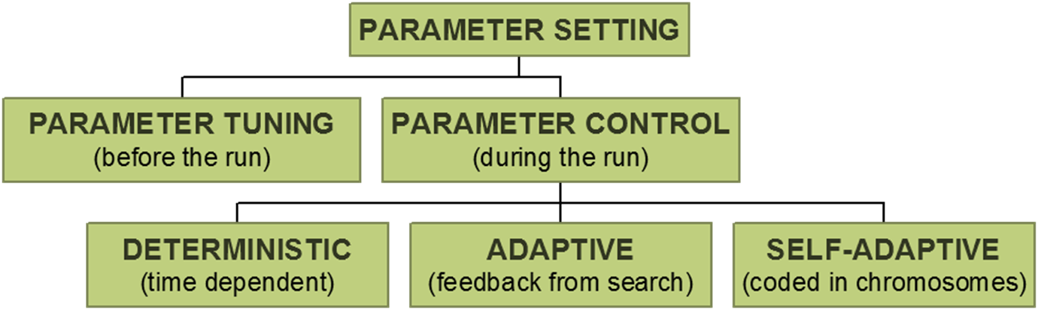
Taxonomy

Slide 5
Parameter tuning
Parameter tuning: testing and comparing different values before the “real” run
Problems:
users mistakes in settings can be sources of errors or sub-optimal performance
costs much time
parameters interact: exhaustive search is not practicable
good values may become bad during the run

Slide 6
Parameter control
Parameter control: setting values on-line, during the actual run, e.g.
predetermined time-varying schedule p = p(t)
using (heuristic) feedback from the search process
encoding parameters in chromosomes and rely on natural selection
Problems:
finding optimal p is hard, finding optimal p(t) is harder
still user-defined feedback mechanism, how to “optimize”?
when would natural selection work for algorithm parameters?
doubling the task for the EA could slow down the runs

Slide 7
Notes on parameter control
Parameter control offers the possibility to use appropriate values in various stages of the search
Adaptive and self-adaptive control can “liberate” users from tuning → reduces need for EA expertise for a new application
Assumption: control heuristic is less parameter-sensitive than the EA
BUT
State-of-the-art is a mess: literature is a potpourri, no generic knowledge, no principled approaches to developing control heuristics (deterministic or adaptive), no solid testing methodology
WHAT ABOUT AUTOMATED TUNING?

Slide 8
Historical account (cont’d)
Lately:
More & more work on parameter control
Traditional parameters: mutation and xover
Non-traditional parameters: selection and population size
All parameters ➔ “parameterless” EAs (name!?)
Not much work on parameter tuning, i.e.,
Nobody reports on tuning efforts behind their EA published
A handful papers on tuning methods / algorithms

Slide 9
Control flow of EA calibration / design
User
Design layer
Meta-GA
optimizes
GP
Algorithm layer
GA
optimizes
Symbolic
regression
Application layer
One-max

Slide 10
Information flow of EA calibration / design
Design layer
Algorithm quality
Algorithm layer
Solution quality
Application layer

Slide 11
Lower level of EA calibration / design
The whole
field of EC
is about this
EA
Searches
Decision variables
Problem parameters
Candidate solutions
Evaluates
Application
Space of solution vectors

Slide 12
Upper level of EA calibration / design
Design method
Searches
Design variables
Algorithm parameters
Strategy parameters
Hyper parameters
Evaluates
EA
Space of parameter vectors

Slide 13
Parameter – performance landscape
All parameters together span a (search) space
One point – one EA instance
Height of point = performance of EA instance on a given problem
Parameter-performance landscape or utility landscape for each { EA + problem instance + performance measure }
This landscape is
not the same as the fitness landscape !
unlikely to be trivial, e.g., unimodal, separable
If there is some structure in the utility landscape, then we can do better than random or exhaustive search

Slide 14
Ontology - Terminology
 | LOWER PART | UPPER PART
METHOD | EA | Tuner
SEARCH SPACE | Solution vectors | Parameter vectors
QUALITY | Fitness | Utility
ASSESSMENT | Evaluation | Test
Fitness ≈ objective function value
Utility = ?
Mean Best Fitness
Average number of Evaluations to Solution
Success Rate
Robustness, …
Combination of some of these

Slide 15
Off-line vs. on-line calibration / design
Design / calibration method
Off-line → parameter tuning
On-line → parameter control
Advantages of tuning
Easier
Most immediate need of users
Control strategies have parameters too → need tuning themselves
Knowledge about tuning (utility landscapes) can help the design of good control strategies
There are indications that good tuning works better than control

Slide 16
Tuning by generate-and-test
EA tuning is a search problem itself
Straightforward approach: generate-and-test
Generate parameter vectors
Test parameter vectors
Terminate

Slide 17
Testing parameter vectors
Run EA with these parameter values on the given problem(s)
Record EA performance in each run e.g., by
Solution quality = best fitness at termination
Speed ≈ time used to find required solution quality
EAs are stochastic → repetitions are needed for reliable evaluation → we get statistics, e.g.,
Average performance by solution quality, speed (MBF, AES)
Success rate = % runs ending with success
Robustness = variance in those averages over different problems
Big issue: how many repetitions of the test

Slide 18
Numeric parameters
E.g., population size, xover rate, tournament size, …
Domain is subset of R, Z, N (finite or infinite)
Sensible distance metric → searchable
EA performance
EA performance
Parameter value
Parameter value
Relevant parameter
Irrelevant parameter

Slide 19
Symbolic parameters
E.g., xover_operator, elitism, selection_method
Finite domain, e.g., {1-point, uniform, averaging}, {Y, N}
No sensible distance metric → non-searchable, must be sampled
EA performance
EA performance
A
B
C
D
E
F
G
H
B
D
C
A
H
F
G
E
Parameter value
Parameter value
Non-searchable ordering
Searchable ordering

Slide 20
Notes on parameters
A given value of a symbolic parameter can introduce a numeric parameter, e.g.,
Selection = tournament → tournament size
Populations_type = overlapping → generation gap
Hence, parameters can have a hierarchical, nested structure
Hence, the number of EA parameters is not defined in general
Cannot simply denote the design space / tuning search space by
S = Q₁ x … Q_{m} x R₁ x … x R_{n}
with Q_{i} / R_{j} as domains of the symbolic/numeric parameters

Slide 21
What is an EA? (1/2)
 | ALG-1 | ALG-2 | ALG-3 | ALG-4
SYMBOLIC PARAMETERS
Representation | Bit-string | Bit-string | Real-valued | Real-valued
Overlapping pops | N | Y | Y | Y
Survivor selection | ̶ | Tournament | Replace worst | Replace worst
Parent selection | Roulette wheel | Uniform determ | Tournament | Tournament
Mutation | Bit-flip | Bit-flip | N(0,σ) | N(0,σ)
Recombination | Uniform xover | Uniform xover | Discrete recomb | Discrete recomb
NUMERIC PARAMETERS
Generation gap | ̶ | 0.5 | 0.9 | 0.9
Population size | 100 | 500 | 100 | 300
Tournament size | ̶ | 2 | 3 | 30
Mutation rate | 0.01 | 0.1 | ̶ | ̶
Mutation stepsize | ̶ | ̶ | 0.01 | 0.05
Crossover rate | 0.8 | 0.7 | 1 | 0.8

Slide 22
What is an EA? (2/2)
Make a principal distinction between EAs and EA instances and place the border between them by:
Option 1
There is only one EA, the generic EA scheme
Previous table contains 1 EA and 4 EA-instances
Option 2
An EA = particular configuration of the symbolic parameters
Previous table contains 3 EAs, with 2 instances for one of them
Option 3
An EA = particular configuration of parameters
Notions of EA and EA-instance coincide
Previous table contains 4 EAs / 4 EA-instances
VOTE

Slide 23
Generate-and-test under the hood
Generate
initial
parameter
vectors
Test p.v.’s
Terminate
Non-iterative
Multi-stage
Iterative
Select p.v.’s
Generate new p.v.’s

Slide 24
Tuning effort
Total amount of computational work is determined by
A = number of vectors tested
B = number of tests per vector
C = number of fitness evaluations per test
Tuning methods can be positioned by their rationale:
To optimize A (iterative search)
To optimize B (multi-stage search)
To optimize A and B (combination)
To optimize C (non-existent)

Slide 25
Optimize A = optimally use A
Applicable only to numeric parameters
Number of tested vectors not fixed, A is the maximum (stop cond.)
Population-based search:
Initialize with N << A vectors and
Iterate: generating, testing, selecting p.v.’s
Meta-EA (Greffenstette ‘86)
Generate: usual crossover and mutation of p.v.’s
SPO (Bartz-Beielstein et al. ‘05)
Generate: uniform random sampling!!! of p.v.’s
REVAC (Nannen & Eiben ’06)
Generate: usual crossover and distribution-based mutation of p.v.’s
Assignment tip
Sequential Parameter Optimization

Slide 26
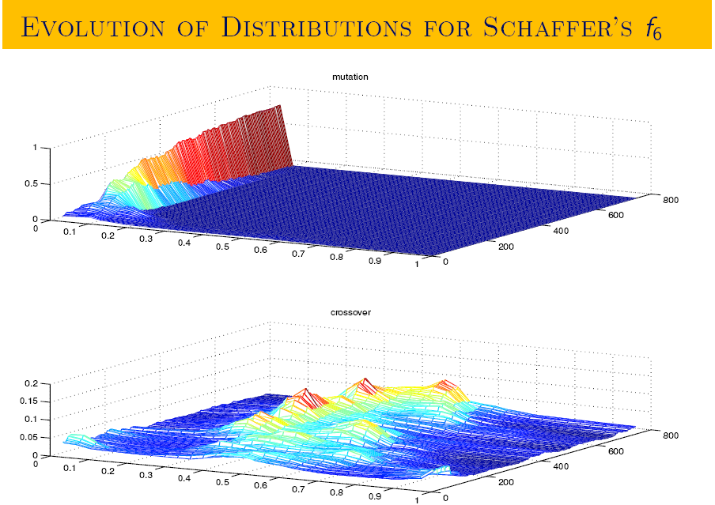
REVAC output illustration

Slide 27
Optimize B = reduce B
Applicable to symbolic and numeric parameters
Number of tested vectors (A) fixed at initialization
Set of tested vectors can be created by
regular method → grid search
random method → random sampling
exhaustive method → enumeration
Complete testing (single stage) vs. selective testing (multi-stage)
Complete testing: nr. of tests per vector = B (thus, not optimizing)
Selective testing: nr. of tests per vector varies, ≤ B
Idea:
Execute tests in a breadth-first fashion (stages), i.e., all vectors tested X < B times
Stop testing vectors with poor utility (lost cause, ditch losers a.s.a.p.)
Well-known methods
ANOVA (Scheffer ‘89)
Racing (Maron & Moore ’97)

Slide 28
Optimize A & B
Existing work:
Meta-EA with racing (Yuan & Gallagher ‘04)
New trick: sharpening (Smit & Eiben 2009)
Idea: test vectors X < B times and increase X over time during the run of a population-based tuner
Improved method:
REVAC with racing & sharpening = REVAC++

Slide 29
Which tuning method?
Differences between tuning algorithms
Maximum utility reached
Computational costs
Number of their own parameters – overhead costs
Insights offered about EA parameters (probability distribution, interactions, relevance, explicit model…)
Similarities between tuning algorithms
Can find good parameter vectors
Nobody is using them
Solid comparisons are rare

Slide 30
Tuning “world champion” EAs
 |  | G-CMA-ES |  |  |  | SaDE
Tuned by |  | Avg | St dev | CEC Δ |  | Avg | St dev | CEC Δ
G-CMA-ES |  | 0.77 | 0.2 | 20 % |  | 0.73 | 0.25 | 49 %
REVAC++ |  | 0.85 | 0.24 | 12 % |  | 0.67 | 0.22 | 53 %
SPOT |  | 0.76 | 0.19 | 22 % |  | 0.73 | 0.20 | 49 %
CEC-2005 |  | 0.97 | 0.32 | - |  | 1.43 | 0.25 | -
Ranking at CEC 2005
CMA-ES
SaDE
Ranking after tuning
SaDE
CMA-ES
Main conclusion: if only they had asked us ….

Slide 31
Tuning vs. not tuning
Performance
Performance
EA 1
EA 2
EA 1
EA 2
EA as is (accidental parameters)
EA as it can be (“optimal” parameters)

Slide 32
Recommendations
DO TUNE your evolutionary algorithm
Think of the “magic constants” (i.e., parameters hidden in the code)
Decide: speed or solution quality?
Decide: specialist of generalist EA?
Measure and report tuning effort

Slide 33
Example study ‘Best parameter values’
Setup:
Problem: Sphere Function (unimodal, simple, often used to test alg. speed)
EA: defined by Tournament Parent Selection, Random Uniform Survivor Selection, Uniform Crossover, BitFlip Mutation
Tuner: REVAC spending X units of tuning effort, tuning for speed
A = 1000, B = 30, C = 10000
Results: the best EA had the following parameter values
Population Size: 6
Tournament Size: 4
...
Conclusions: for this problem we need a high (parent) selection pressure. This is probably because the problem is unimodal

Slide 34
Example study ‘Good parameter values’
Setup: same as before
Results: The 25 best parameters vectors have their values within the following ranges
Mutation Rate: [0.01, 0.011]
Crossover Rate: [0.2, 1.0]
(..)
Conclusions: for this problem the mutation rate is much more relevant than the crossover rate.

Slide 35
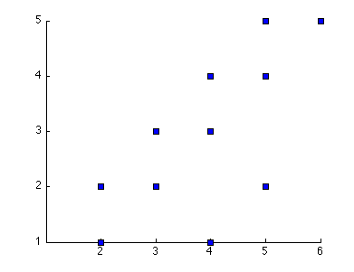
Example study ‘interactions’
Setup: same as before
Results: plotting the population size and generation gap of the best parameter vectors shows
the following
Conclusions: for this problem the best results are obtained when (almost) the complete population is replaced every generation.
Generation Gap
Population size

Slide 36
The (near) future of automated tuning
Hybrid methods for A & B
Well-funded EA performance measures, multi-objective formulation → multi-objective tuner algorithms
(Statistical) models of the utility landscape → more knowledge about parameters
Open source toolboxes
Distributed execution
Good testbeds
Adoption by the EC community
Rollout to other heuristic methods with parameters

Slide 37
Culture change?
Fast and good tuning can lead to new attitude
Past & present: robust EAs preferred
Future: problem-specific EAs preferred
Old question: what is better the GA or the ES?
New question: what symbolic configuration is best?
… given a maximum effort for tuning
New attitude / practice:
tuning efforts are measured and reported
EAs with their practical best settings are compared, instead of unmotivated “magical” settings

Slide 38
Important points
Parameters vs. parameter values
Some parameters do matter much, some don’t
Tune the (right) parameters to increase performance
Decide what you tune for, e.g. for speed (AES) or quality (MBF, SR)
Any tuner is better than no tuner

